Slide 1
Employee Data Analysis using Excel
STUDENT NAME:J.RAJESHWARI
REGISTER NO:312216516 autunm1647cb1221647016
DEPARTMENT: B.COM(BM)
COLLEGE:R.B GOTHI JAIN COLLEGE FOR WOMEN

Slide 2
PROJECT TITLE
Employee Performance Analysis using Excel

Slide 3


AGENDA
Problem Statement
Project Overview
End Users
Our Solution and Proposition
Dataset Description
Modelling Approach
Results and Discussion
Conclusion
3/21/2024 Annual Review

Slide 4

PROBLEM STATEMENT
Employee performance analysis using Excel involves evaluating
and measuring an employee‘s work effectiveness and efficiency
based on key performance indicators (KPls).This data is then analyzed
using Excel‘Sari functions and tools,such as pivot tables,charts,and
Conditional formatting, to identify patterns, strengths, and areas for
Improvement. The analysis helps in making informed decision
regarding training needs,promotions, and overall workforce optimization

Slide 5

PROJECT OVERVIEW
.
The project “Employee performance Analysis Using Excel” aims to
Systematically evaluate employee productivity and effectiveness by
leveraging Excel’s analytical tools. The project will involves collecting
And organizing performance data such as task completion rates,accuracy, and attendance records. The outcome will help in
Identifying top performers,recognizing training needs,and making
data-driven decisions for performance improvement. The final
deliverable will include a detailed report and visual dashboards for
easy interpretation and strategic planning.

Slide 6
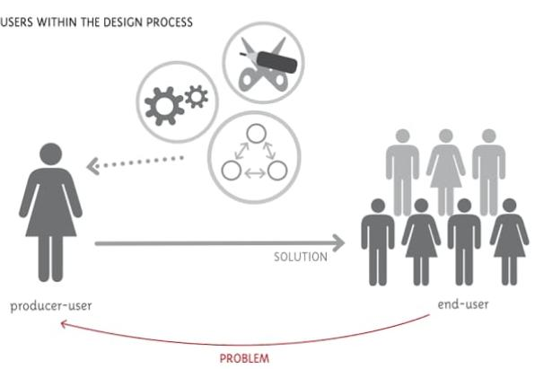

WHO ARE THE END USERS?
Organization
Employee manager
HRM

Slide 7

OUR SOLUTION AND ITS VALUE PROPOSITION
DATA –DRIVEN INSIGHTS : Enables managers to make informed decisions
based on accurate, real-time performance data
IMPROVED EFFICIENCY: Automates the data collection and analysis
Process, saving time and reducing manual errors

Slide 8
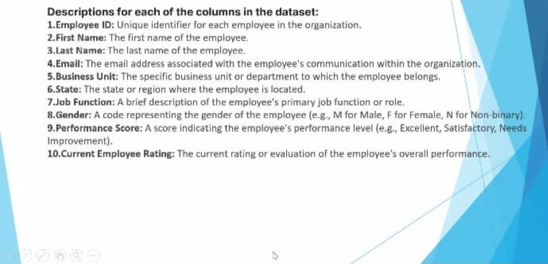
Dataset Description

Slide 9

THE "WOW" IN OUR SOLUTION
PREDICTIVE ANALYTICS: Integrating predictive models to forecasts future performance
trends based on historical data, giving managers a proactive approach
to workforce planning
AUTOMATED ALERTS: The tool can be set up to send automated alerts for critical
Performance issues, ensuring that managers
3/21/2024 Annual Review
9

Slide 10
MODELLING
DATA FILTERING:
PURPOSE: To sort and refine the data to focus on specific criteria, such as department, data range ,or individual employee performance.
PIVOT TABLES :
PURPOSE: To summarize and analyze large datasets by grouping and aggregating
data based on different performance metrics.
10

Slide 11
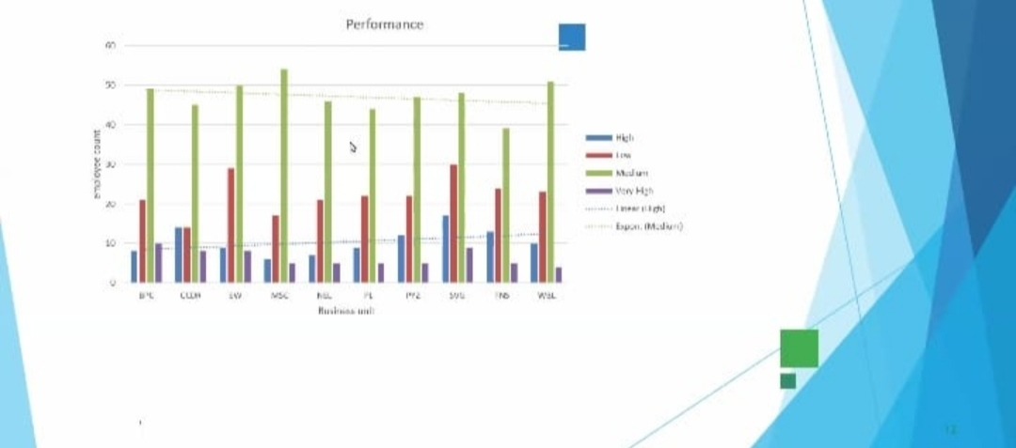
RESULTS
11

Slide 12
conclusion
The “Employee performance Analysis Using Excel ”project provides a robust and user.Friendly
Solution for evaluating and managing employee performance .By leveraging Excel’s powerful
Tools such as filtering .This solution not only streamlines performance management but also offers
a cost- Effective, scalable approach to enhancing overall organizational efficiency

